Slide 1
Toronto Rental Prices

Slide 2
Problem Statement
Rental prices in Toronto are among the highest in the country
The market is competitive and decisions need to be made quickly
The city is large enough that it can be difficult to estimate an appropriate price for any given property that considers not only the property, but also the neighborhood

Slide 3
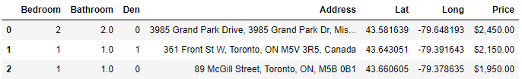
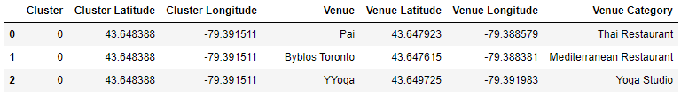
Data
2018 Toronto Rental Data
Foursquare Location Data
Geopy distances (to determine distance of rental from city centre)

Slide 4
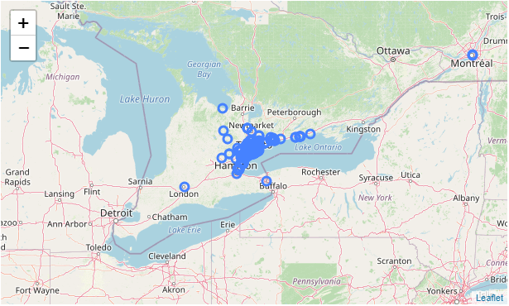
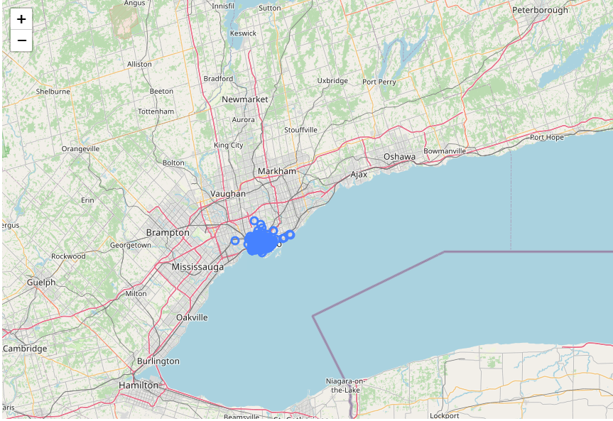
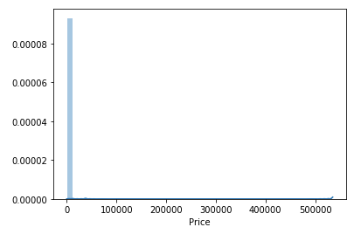
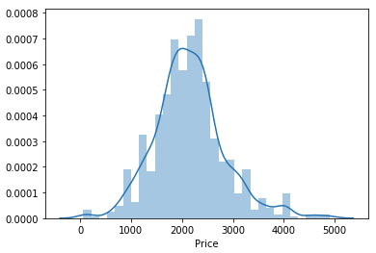
Methodology – Data Preparation
Remove outliers and include only Toronto data based on postal codes

Slide 5
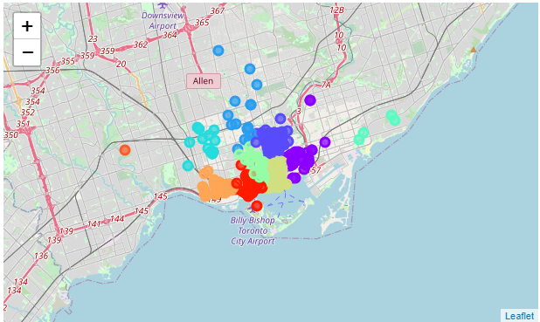
Methodology - Clustering
Create 10 clusters based on location to collect Foursquare data using kmeans

Slide 6
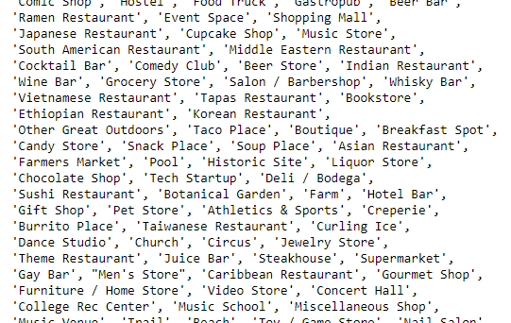
Methodology – FourSquare Data
Assume that the higher the number of restaurants among the top 100 venues in a neighborhood, the more desirable and more expensive the area
Extract restaurants from 194 venue categories based on keywords:
“Restaurant”
“Joint”
“Place”
“Coffee Shop”
“Breakfast Spot”

Slide 7
Methodology – Model Development
Split data into training and testing sets
Using training set to perform multiple linear regression of increasing order polynomials
Choose model based on highest R² value
X1 | X2 | X3 | X4 | X5
# of Bedrooms | # of Bathrooms | Existence of Den | # of Restaurants | Distance to Centre
Y
Price

Slide 8
Results
Best model fit was achieved with a first order polynomial and an R² value of 0.364
Price = 548(# of bedrooms) + 492(# of bathrooms) + 367(existence of den) – 13(# of restaurants) – 71(distance to centre) + 1497

Slide 9
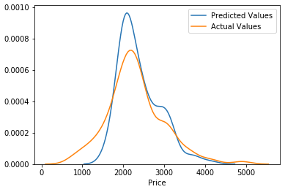
Results
Testing set distribution of actual versus predicted values

Slide 10
Discussion & Conclusions
Overall, model fit was not very strong with a maximum R² value of 0.364
The impact of restaurants in the area was opposite of expected (i.e. more restaurants decreased the price)
There may be a better way to use Foursquare location data to evaluate the impact of nearby amenities on price
The availability of more data may help to refine the model, but it appears that other inputs would be required to explain more of the variability

